Slide 1
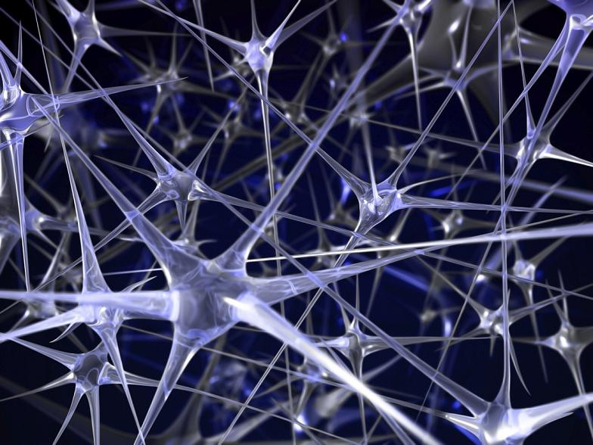
Artificial Neural Networks
Harvey Alférez, PhD
www.harveyalferez.com
Notes:
A neuron cell, as seen in Figure 1.1, accepts signals from dendrites. When a neuron
accepts a signal, that neuron may fire. When a neuron fires, a signal is transmitted
over the neuron’s axon. Ultimately, the signal will leave the neuron as it travels to the
axon terminals. The signal is then transmitted to other neurons or nerves.

Slide 2
Introduction
This course provides an introduction to artificial neural networks.
Practical point of view: Know How.

Slide 3
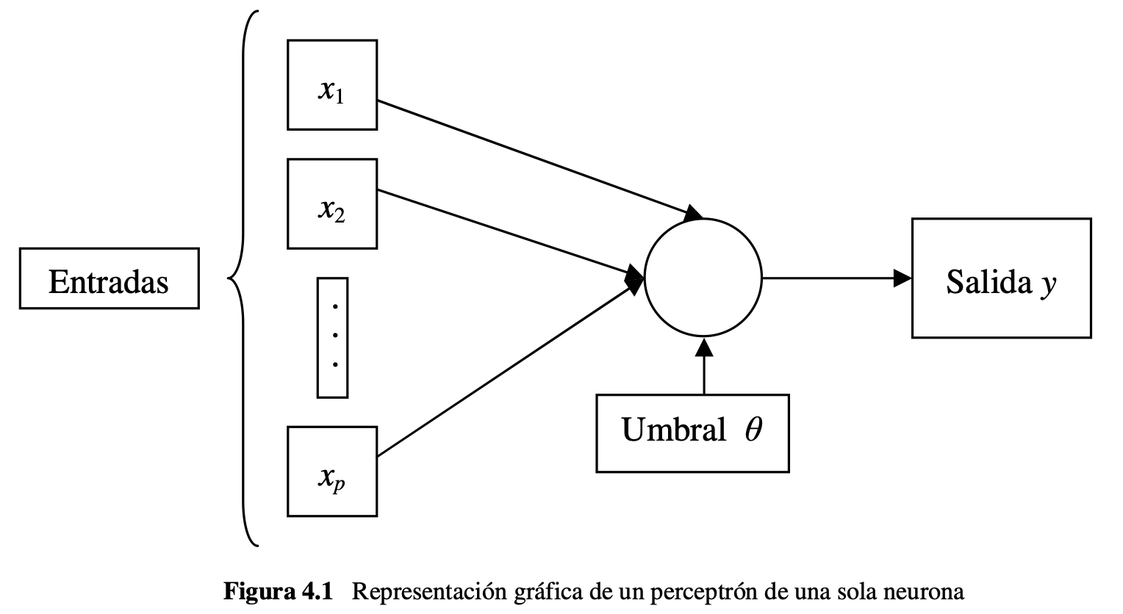
A Historical Perspective on Neural Networks
Neural networks have been used with computers since the 1950s.
Perceptron.

Slide 4
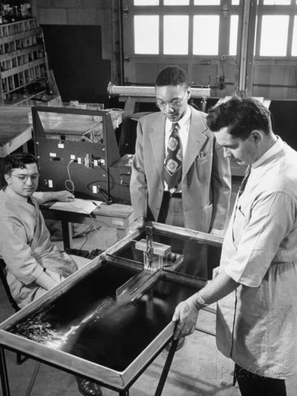
Perceptron
The perceptron is one of the earliest neural networks.
Invented at the Cornell Aeronautical Laboratory in 1957 by Frank Rosenblatt.
An attempt to understand human memory, learning, and cognitive processes.
In 1960, Rosenblatt demonstrated the Mark I perceptron.
The first machine that could “learn” to identify optical patterns.

Slide 5
Perceptron (Cont.)
http://www.youtube.com/watch?v=vGwemZhPlsA

Slide 6
Perceptron (Cont.)
The perceptron progressed through biological neural studies
McCulloch and Pitts were the first to describe biological neural networks, and are credited with coining the phrase “neural network.”
They developed a simplified model of the neuron, called the MP neuron, centered on the idea that a nerve will fire only if its threshold value is exceeded.
The MP neuron functioned as a sort of scanning device that read predefined input and output associations to determine the final output.

Slide 7
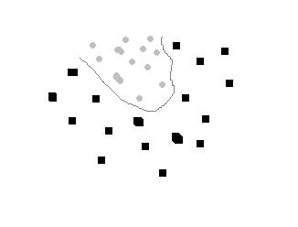
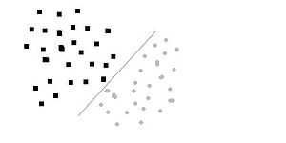
Perceptron (Cont.)
The perceptron was unable to learn to recognize input that was not “linearly separable.”
A huge obstacle that would take some time to overcome.

Slide 8
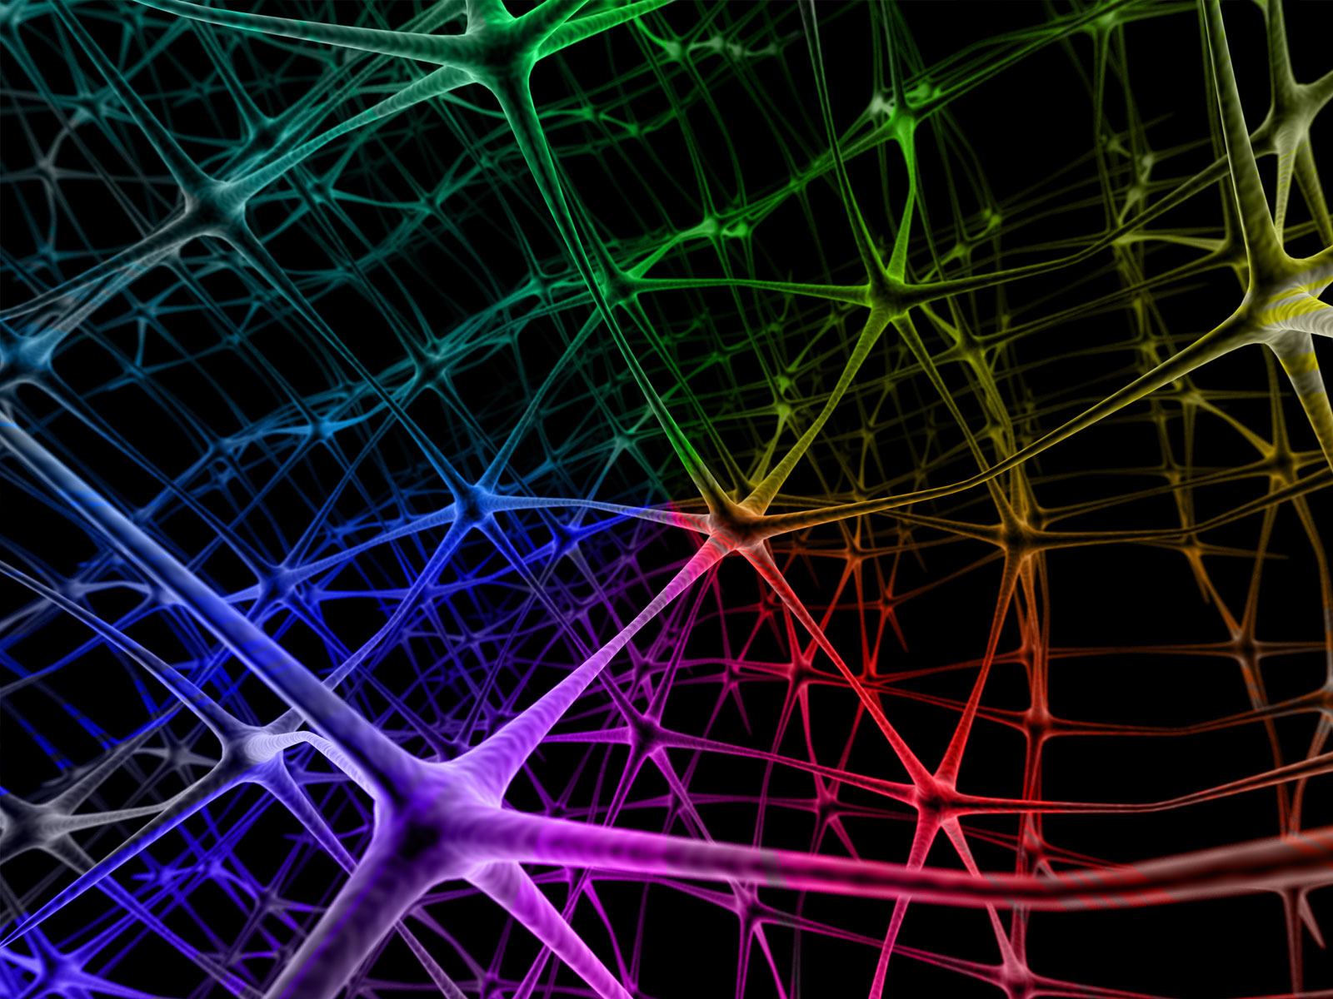
Overview of Neural Networks
Understanding Biological Neural Networks
How an Artificial Neural Network is Constructed
Appropriate Uses for Neural Networks

Slide 9

Overview of Neural Networks (Cont.)
Computers can perform many operations considerably faster than a human being. Can you list some?
There are many tasks for which the computer falls considerably short of its human counterpart. Can you list some examples?

Slide 10



Overview of Neural Networks (Cont.)

Slide 11
How is a Biological Neural Network Constructed?
The term neural network, as it is normally used, is actually a misnomer.
Computers attempt to simulate biological neural networks by implementing artificial neural networks.
However, most publications use the term “neural network,” rather than “artificial neural network” (ANN).

Slide 12
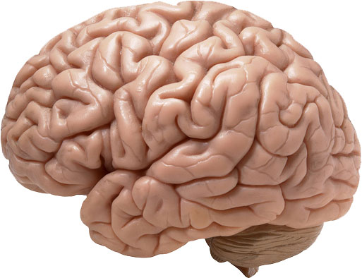
How is a Biological Neural Network Constructed? (Cont.)
To construct a computer capable of “human-like thought,” researchers have used the only working model they have available—the human brain.
However, the human brain as a whole is far too complex to model.
Rather, the individual cells that make up the human brain are studied: neuron cells.

Slide 13
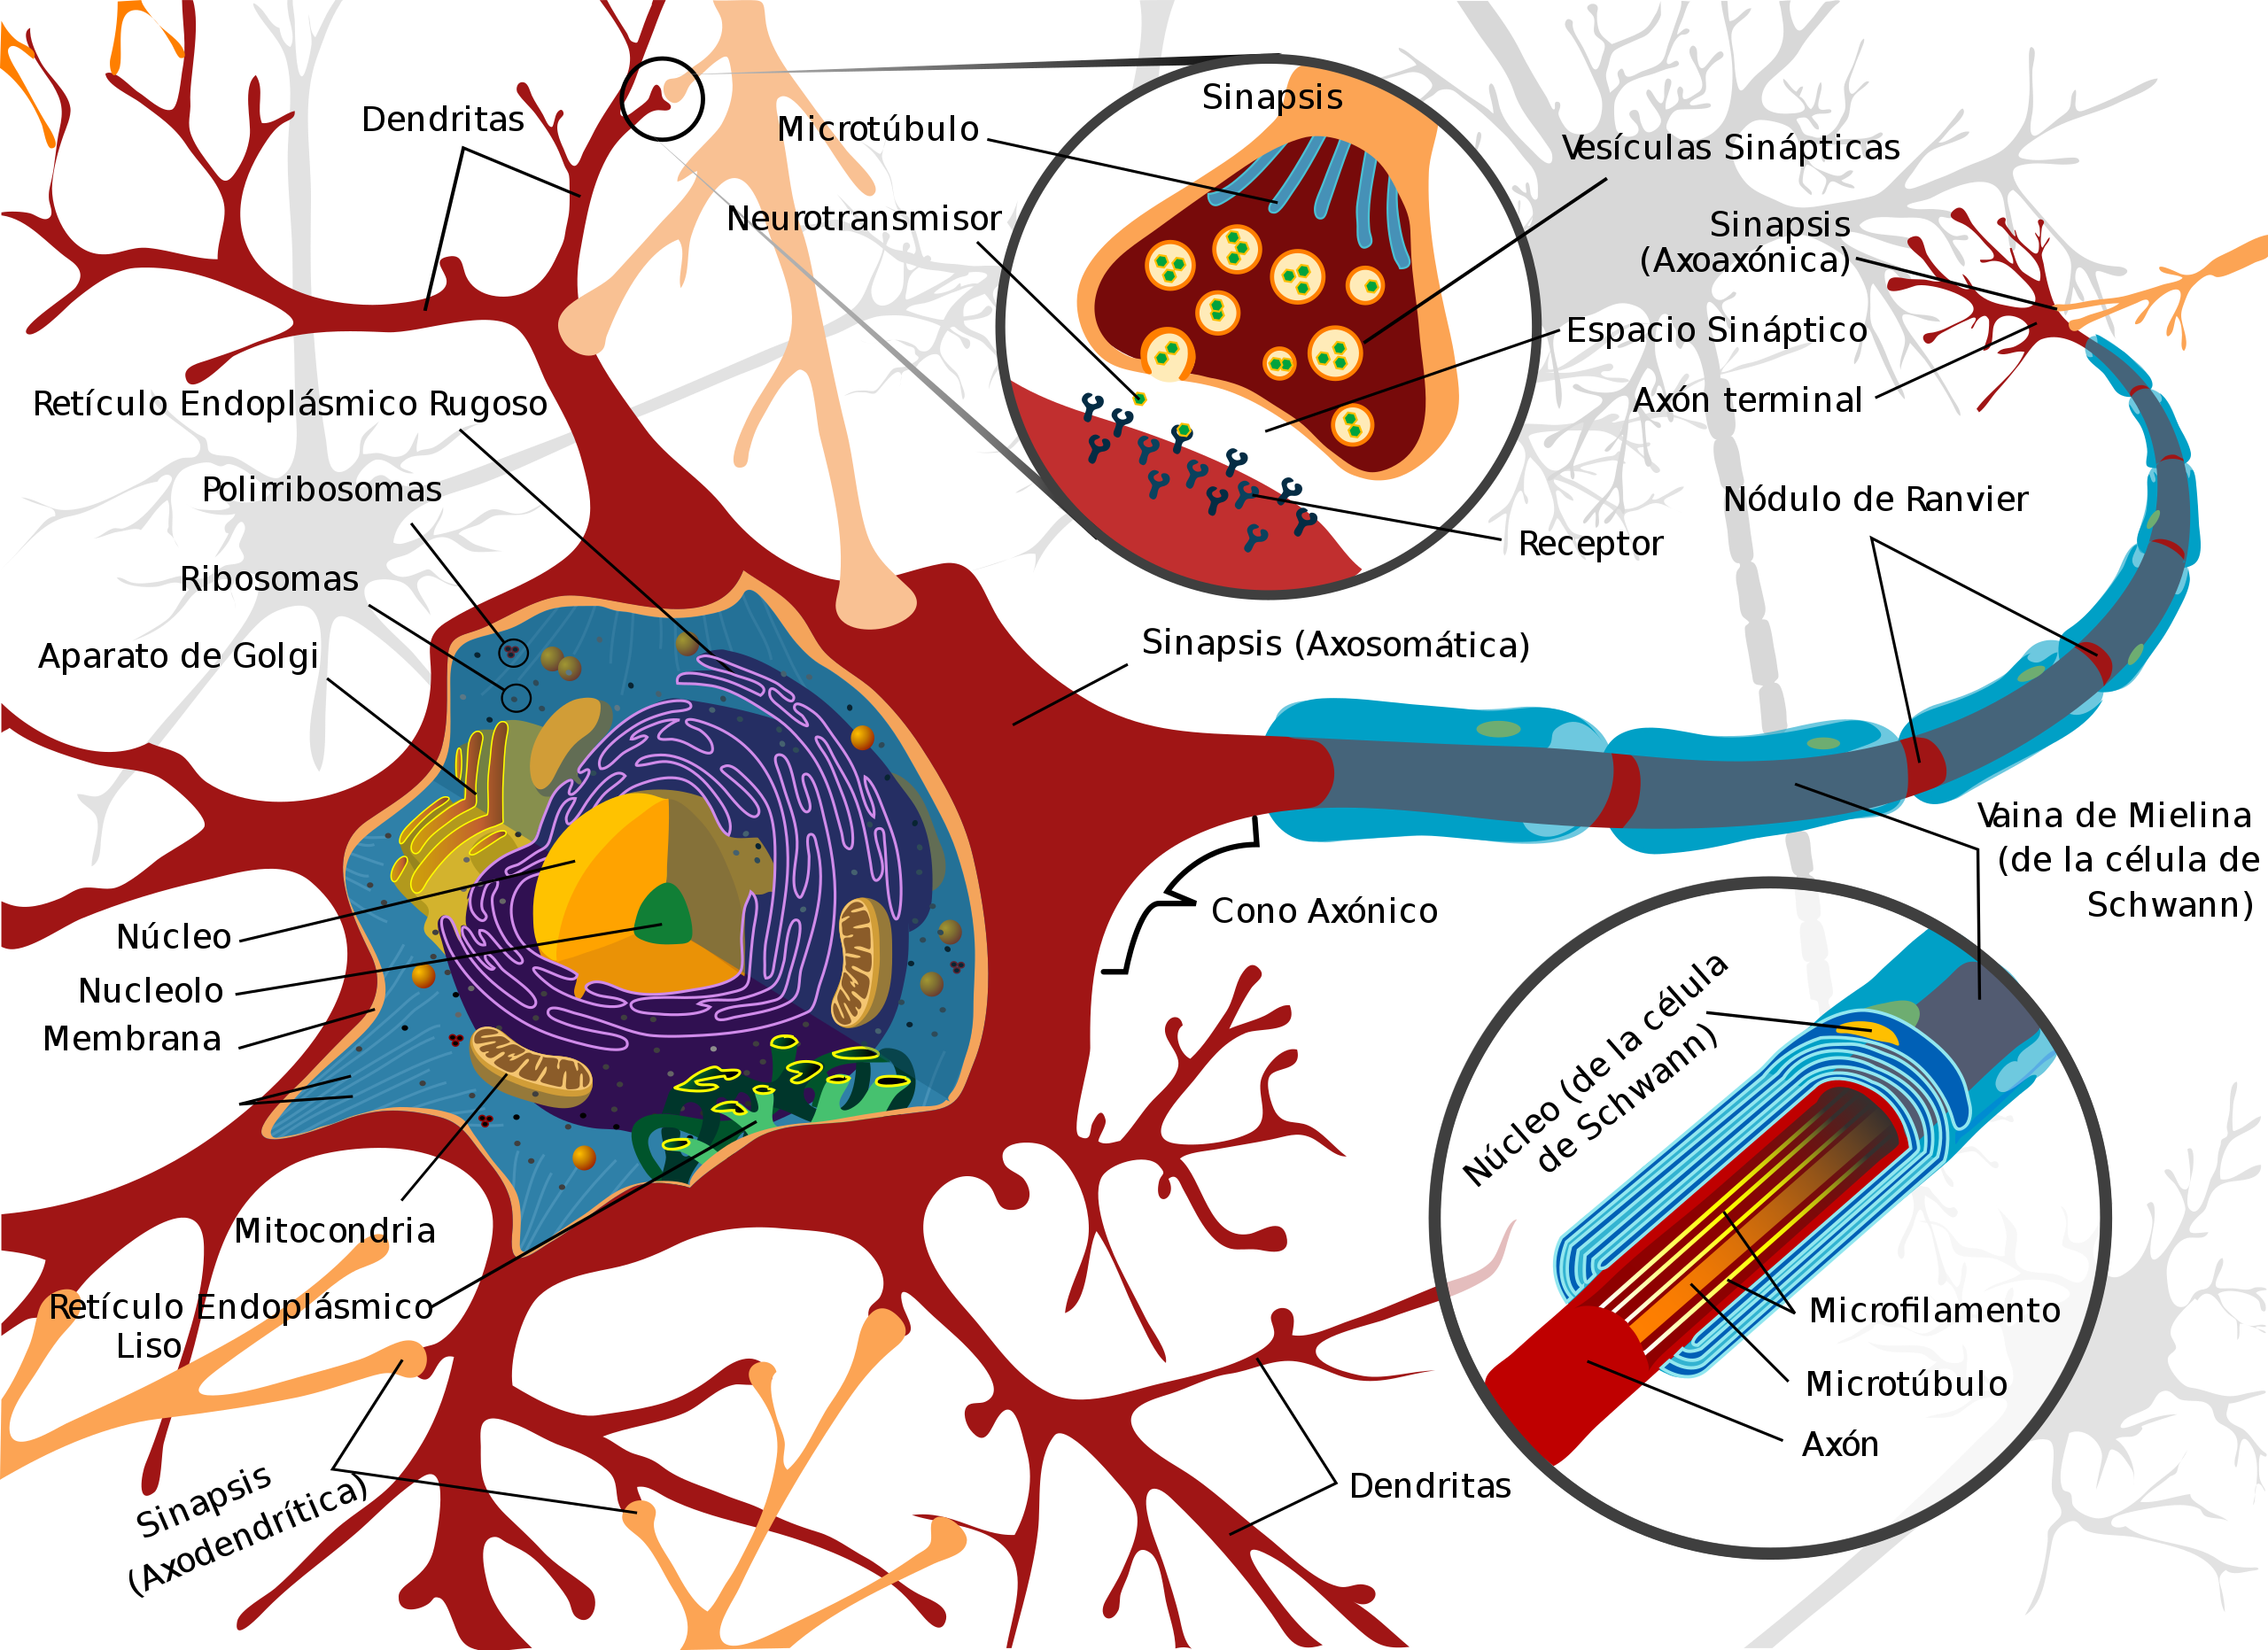
How is a Biological Neural Network Constructed?(Cont.)
The signal, transmitted by a neuron, is an analog signal.
Biological neural networks are analog.

Slide 14
How is a Biological Neural Network Constructed? (Cont.)
When a neuron fires, a new analog signal is transmitted from the firing neuron to other neurons.
This signal is conducted over the firing neuron’s axon.
The regions of input and output are called synapses.
A neuron makes a decision by firing or not firing.
The decisions being made are extremely low-level decisions.
Higher-level decisions are the result of the collective input and output of many neurons.
Artificial neural networks are based on this model.

Slide 15
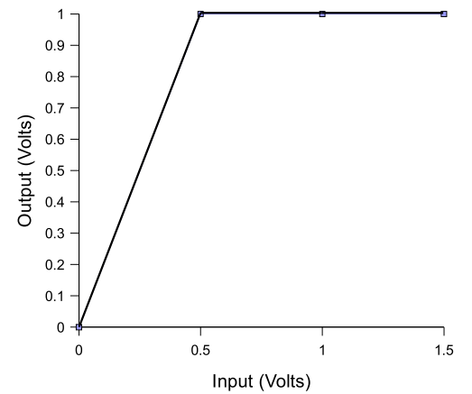
How is a Biological Neural Network Constructed? (Cont.)
Decisions can be represented graphically by charting the input and output of neurons.
Notes:
Decisions can be represented graphically by charting the input and output of neurons. Figure 1.4 illustrates the input and output of a particular neuron. Looking at the graph shown in Figure 1.4, it can be seen that the neuron in this example will fire at any input greater than 0.5 volts.

Slide 16
Problems Not Suited to a Neural Network Solution
Programs that are easily written out as flowcharts (consists of well-defined steps).
If the algorithm used to solve your problem is an unchanging business rule, there is no reason to use a neural network.
It might be detrimental to your application if the neural network attempts to find a better solution, and begins to diverge from the desired process and produces unexpected results.
Problems in which you must know exactly how the solution was derived.
A neural network can solve the problem for which it was trained, but it cannot explain its reasoning.

Slide 17
Problems Suited to a Neural Network
Neural networks are particularly useful for solving problems that cannot be expressed as a series of steps.
Types of problem that are frequently solved with neural networks:
Classification
Prediction
Pattern recognition
Optimization

Slide 18
Problems Suited to a Neural Network (Cont.)
Classification.
A neural network trained for classification is designed to take input samples and classify them into groups.
Optical character recognition (OCR): takes handwriting samples and classifies them by letter (e.g. “A” or “B”).
An online organization may want its email system to classify incoming mail into groups of spam and non-spam messages.

Slide 19
Problems Suited to a Neural Network (Cont.)
Prediction
Given a time-based series of input data, a neural network will predict future values.
The accuracy of the guess will be dependent upon many factors, such as the quantity and relevancy of the input data.
Predict movements in financial markets.

Slide 20
Problems Suited to a Neural Network (Cont.)
Pattern recognition is perhaps the most common use for neural networks (a form of classification).
For this type of problem, the neural network is presented a pattern (an image, a sound, or any other data).
The neural network then attempts to determine if the input data matches a pattern that it has been trained to recognize.
The pattern must be recognized even when it is distorted.
Notes:
Every person who holds a driver’s license should be able to accurately identify a
traffic light. This is an extremely critical pattern recognition procedure carried out by
countless drivers every day. However, not every traffic light looks the same, and the
appearance of a particular traffic light can be altered depending on the time of day or
the season. In addition, many variations of the traffic light exist. Still, recognizing a
traffic light is not a hard task for a human driver.

Slide 21
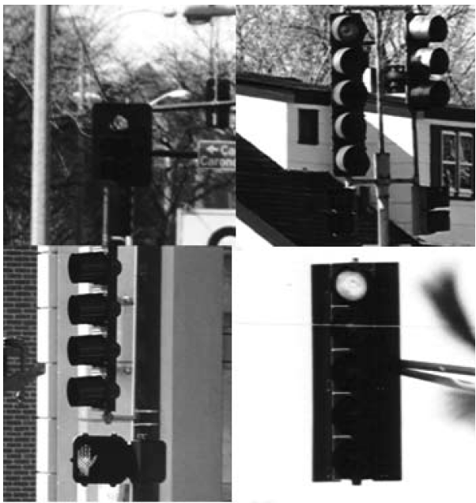
Problems Suited to a Neural Network (Cont.)
How hard is it to write a computer program that accepts an image and tells you if it is a traffic light?
Notes:
Without the use of neural networks, this could be a very complex
task. Figure 1.5 illustrates several different traffic lights. Most common programming
algorithms are quickly exhausted when presented with a complex pattern recognition
problem.

Slide 22
Problems Suited to a Neural Network (Cont.)
Optimization
The neural network may not always find the optimal solution; rather, it seeks to find an acceptable solution.
The traveling salesman problem
A salesman must visit a set number of cities.
He would like to visit all cities and travel the fewest number of miles possible.
With a large number of cities, brute force methods of calculation do not work nearly as well as a neural network approach.
Notes:
Without the use of neural networks, this could be a very complex
task. Figure 1.5 illustrates several different traffic lights. Most common programming
algorithms are quickly exhausted when presented with a complex pattern recognition
problem.

Slide 23
Training Neural Networks
The individual neurons that make up a neural network are interconnected through their synapses.
Connections allow the neurons to signal each other as information is processed.
Not all connections are equal. Each connection is assigned a connection weight.
If there is no connection between two neurons, then their connection weight is zero.
These weights are what determine the output of the neural network -> The connection weights form the memory of the neural network.

Slide 24
Training Neural Networks (Cont.)
Training is the process by which connection weights are assigned.
Most training algorithms begin by assigning random numbers to a weights matrix.
Then, the validity of the neural network is examined.
Next, the weights are adjusted based on how well the neural network performed and the validity of the results.
This process is repeated until the validation error is within an acceptable limit.

Slide 25
Validating Neural Networks
Validating a neural network allows you to determine if additional training is required.
To correctly validate a neural network, validation data must be set aside that is completely separate from the training data.
Notes:
As an example, consider a classification network that must group elements into
three different classification groups. You are provided with 10,000 sample elements.
For this sample data, the group that each element should be classified into is known.
For such a system, you would randomly divide the sample data into two groups of
5,000 elements each. The first group would form the training set. Once the network
was properly trained, the second group of 5,000 elements would be used to validate the
neural network.
It is very important that a separate group of data always be maintained for valida-
tion. First, training a neural network with a given sample set and also using this same
set to predict the anticipated error of the neural network for a new arbitrary set will
surely lead to bad results. The error achieved using the training set will almost always
be substantially lower than the error on a new set of sample data. The integrity of the
validation data must always be maintained.

Slide 26
Validating Neural Networks (Cont.)
What happens if the neural network that you have just finished training performs poorly on the validation data set?
If this is the case, then you must examine possible causes.
It could mean that the initial random weights were not appropriate. Rerunning the training with new initial weights could correct this.
A more likely possibility is that the training data was not properly chosen.

Slide 27
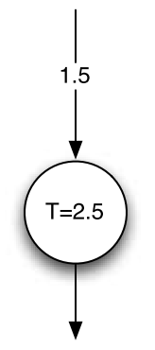
Using a Simple Neural Network
weight
threshold
An incoming signal will be amplified, or de-amplified, by the weight as it crosses
the incoming synapse.
If the weighted input exceeds the threshold, then the neuron will fire.
Artificial Neuron
Notes:
Consider a value of one ( true ) presented as the input to the neuron. The value
of one will be multiplied by the weight value of 1.5. This results in a value of 1.5. The
value of 1.5 is below the threshold of 2.5, so the neuron will not fire. This neuron will
never fire with Boolean input values. Not all neurons accept only boolean values. However, the neurons in this section only accept the boolean values of one ( true ) and zero (false).

Slide 28
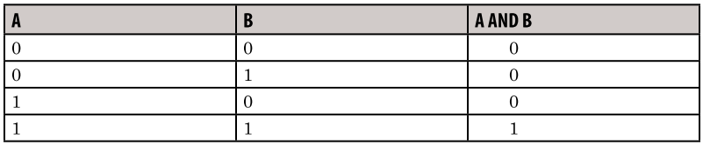
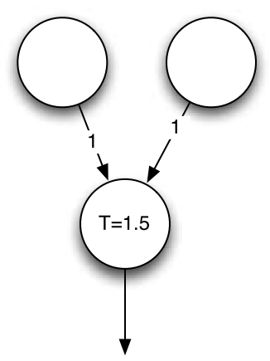
A Neural Network for the And Operator
Notes:
The neuron shown in Figure 1.6 is not terribly useful. However, most neurons are
not terribly useful—at least not independently. Neurons are used with other neurons
to form networks. We will now look at a neural network that acts as an AND gate.
Table 1.1 shows the truth table for the AND logical operation.
A simple neural network can be created that recognizes the AND logical opera-
tion. There will be three neurons in total. This network will contain two inputs and
one output. A neural network that recognizes the AND logical operation is shown in
Figure 1.7.
There are two inputs to the network shown in Figure 1.7. Each neuron has a
weight of one. The threshold is 1.5. Therefore, a neuron will only fire if both inputs
are true . If either input is false , the sum of the two inputs will not exceed the
threshold of 1.5.
Consider inputs of true and false . The true input will send a value of one
to the output neuron. This is below the threshold of 1.5. Likewise, consider inputs of
true and true . Each input neuron will send a value of one. These two inputs are
summed by the output neuron, resulting in two. The value of two is greater than 1.5,
therefore, the neuron will fire.

Slide 29
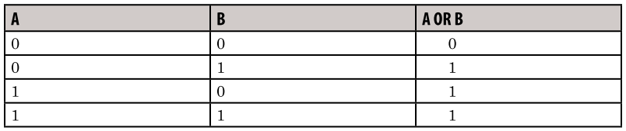
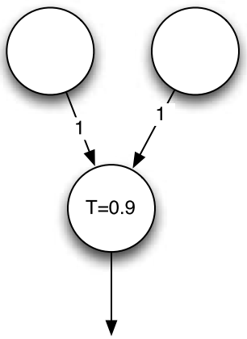
A Neural Network for the Or Operation
Notes:
The OR neural network looks very similar to the AND neural network. The biggest
difference is the threshold value. Because the threshold is lower, only one of the inputs
needs to have a value of true for the output neuron to fire.

Slide 30
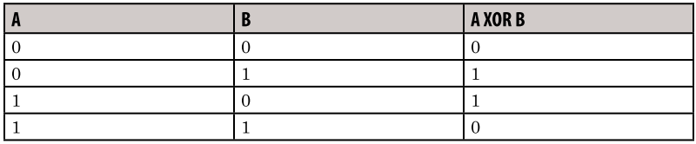
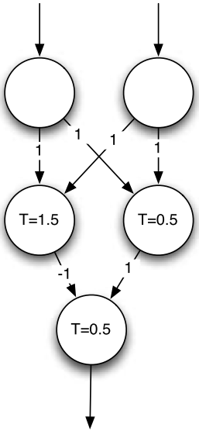
A Neural Network for the XOR Operation
Hiden layer
Notes:
The XOR logical operation requires a slightly more complex neural network than
the AND and OR operators. The neural networks presented so far have had only two
layers— an input layer and an output layer. More complex neural networks also in-
clude one or more hidden layers. The XOR operator requires a hidden layer. As a
result, the XOR neural network often becomes a sort of “Hello World” application for
neural networks.
Figure X shows a three-layer neural network that can be used to recognize the
XOR operator.
Consider the case in which the values of true and true are presented to this
neural network. Both neurons in the hidden layer receive the value of two. This is
above the thresholds of both of the hidden layer neurons, so they will both fire. How-
ever, the first hidden neuron has a weight of -1, so its contribution to the output neuron
is -1. The second neuron has a weight of 1, so its contribution to the output neuron is
1. The sum of 1 and -1 is zero. Zero is below the threshold of the output neuron, so the
output neuron does not fire. This is consistent with the XOR operation, because it will
produce false if both inputs are true .
Now consider if the values of false and true are presented to the neural net-
work. The input to the first hidden layer neuron will be 1, from the second input neu-
ron. This is lower than the threshold of 1.5, so it will not fire. The input to the second
hidden layer neuron will also be 1, from the second input neuron. This is over the 0.5 threshold, so it will fire. The input to the output neuron will be zero from the left hid-
den neuron and 1 from the right hidden neuron. This is greater than 0.5, so the output
neuron will fire. This is consistent with the XOR operation, because it will produce
true if one of the input neurons is true and the other false .
Of course, the neural networks shown in the preceding sections are very simple.
However, they illustrate all of the key points for more complex neural networks.

Slide 31
How to Make a Neural Network in Your Bedroom: Brittany Wenger
http://www.youtube.com/watch?v=n-YbJi4EPxc

Slide 32
Summary
ANN
Suitable for processes that cannot easily be broken into a finite number of steps.
Attempts to simulate the biological neural networks.
First introduced in the 1950’s.
Through the years of their development have experienced numerous setbacks.
They have yet to deliver on the promise of simulating human thought.
Neural networks are constructed of neurons that form layers.

Slide 33
Summary (Cont.)
If the input to a neuron is within the range that the neuron has been trained for, then the neuron will fire.
Neural networks must be trained and validated.
A training set is usually split in half to provide both a training and validation set.
Training the neural network consists of running the neural network over the training data until the neural network learns to recognize the training set with a sufficiently low error rate.
Validation occurs when the neural network’s results are checked:
Presenting the validation set to the neural network and comparing the actual results produced by the neural network with the anticipated results.

